Slide 1
SerDes basics Dmitry Vasilchenko
Where today meets tomorrow.
Restricted © Siemens 2022

Slide 2
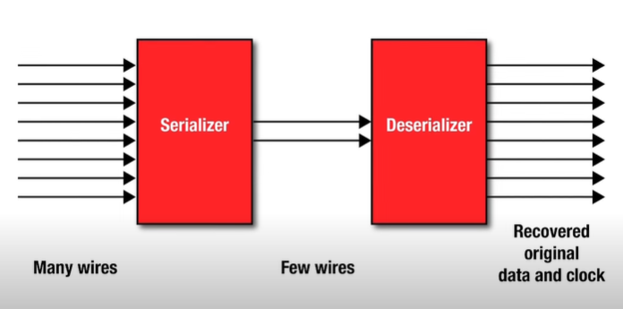
SerDes
Serializer-Deserializer
Supports much high data rate
Reduces noise, EMI
Reduces wires
Use low volts diff signals
Data transfer rate
Cable (diff, serial) USB, HDMI (~4 Gbps), FireWire
IO bus (diff, parallel) PCIe (8 Gbps)
Ethernet (diff, serial) 100GBase (25 Gbps)
Memory (single-ended, parallel) DDR4, LPDDR4 (~4 Gbps)

Slide 3
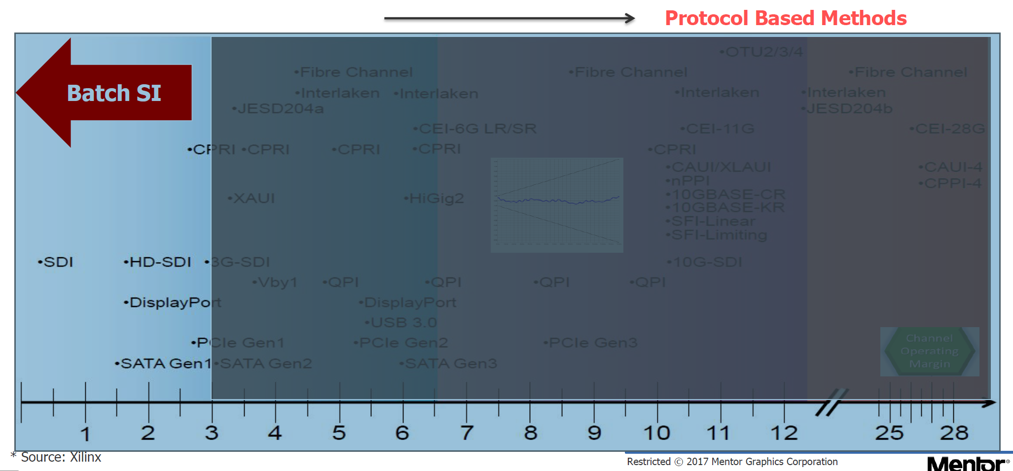
SerDes protocols

Slide 4
Summary

Slide 5
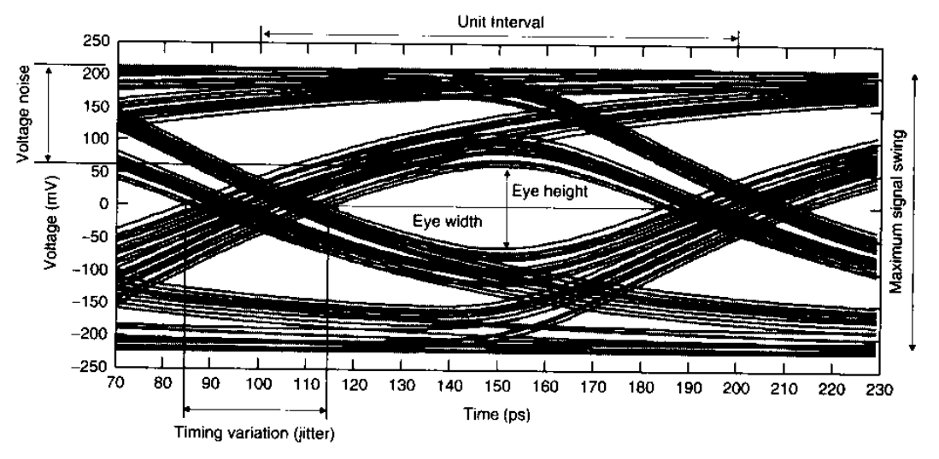
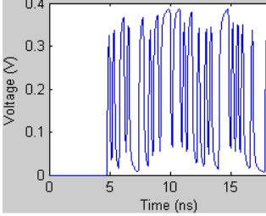
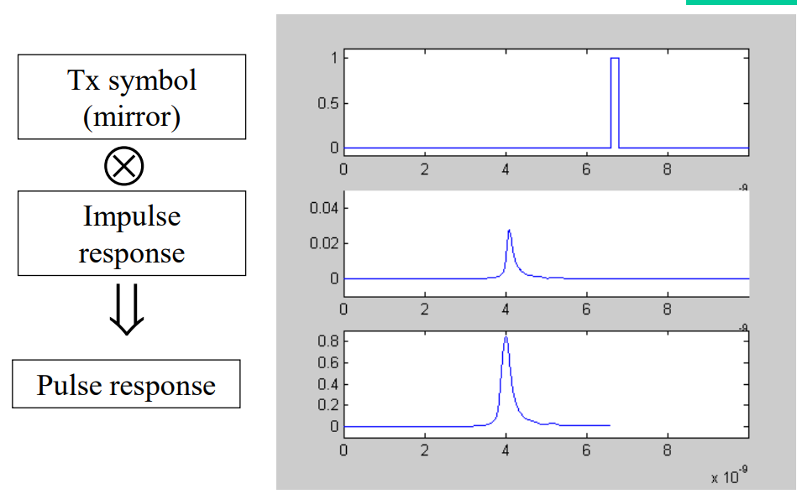
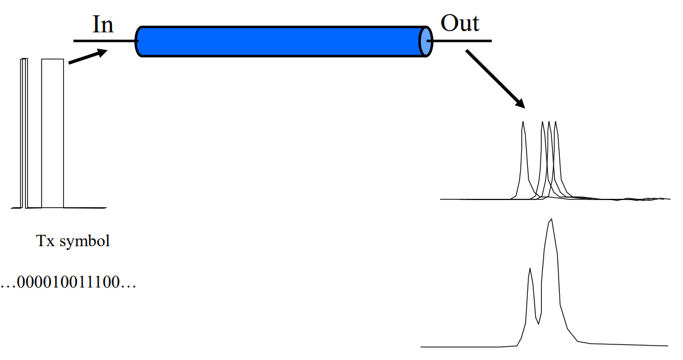
Eye diagram
Use PRBS Stimulus 00000101110100101110110…
Run Time domain simulation
Slice waveform at 1 UI (unit interval) and overlap waveform pieces
Opened eye means RX can recognize TX symbols basing on voltage level at UI/2
Works, but time domain simulations are impractical for more than 10K bits
(slow, huge waveforms).
SerDes link usually needs 25K just to handshake and settle
Fast Eye
For Linear Time-Invariant (LTI) System we build waveform from s-parameter (freq domain) using convolution and superposition:

Slide 6
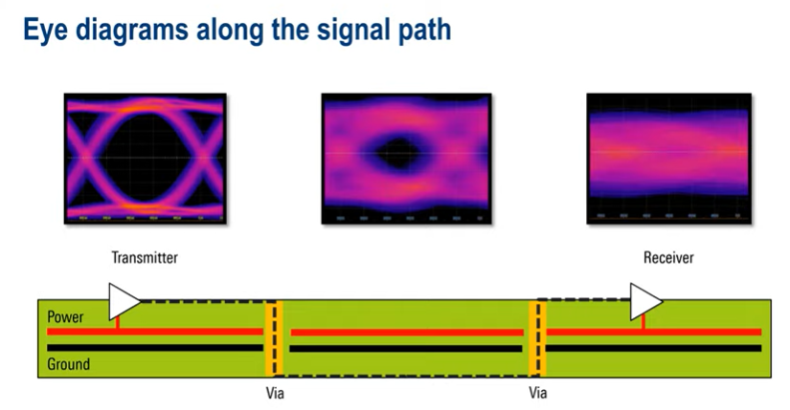
Eye distortion
Lossy effects
Skin effect
Dielectric loss
Reflections
Via stubs
Impedance mismatch
Termination
Crosstalk
Ground bounce
Return path
Jitter
EMI

Slide 7
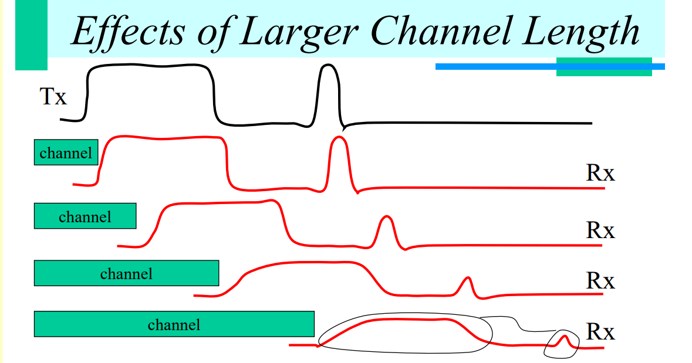
Signal attenuation and distortion, 011111000010000

Slide 8
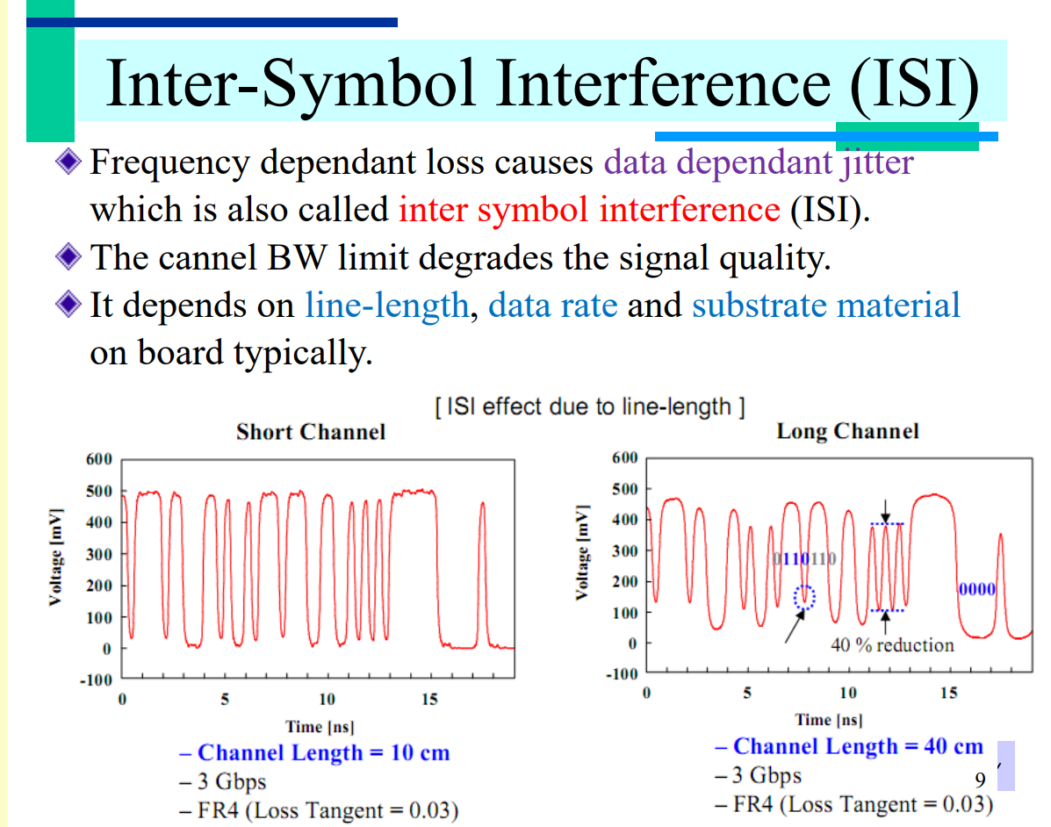
ISI

Slide 9
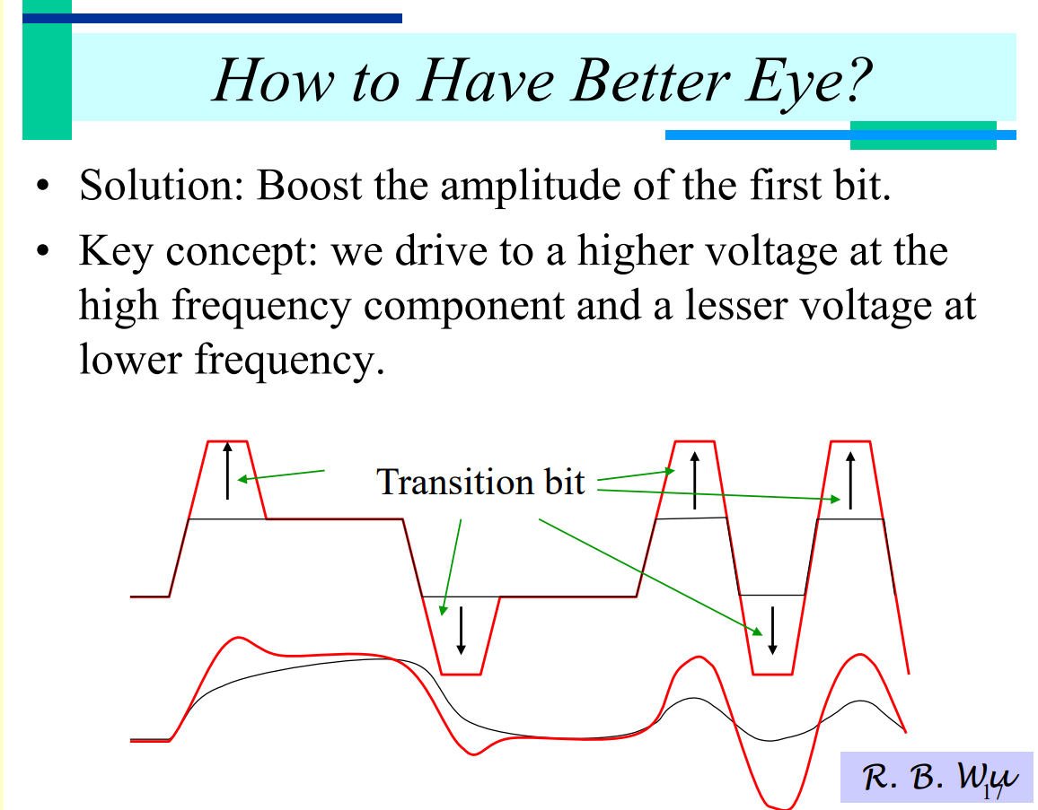
Summary

Slide 10
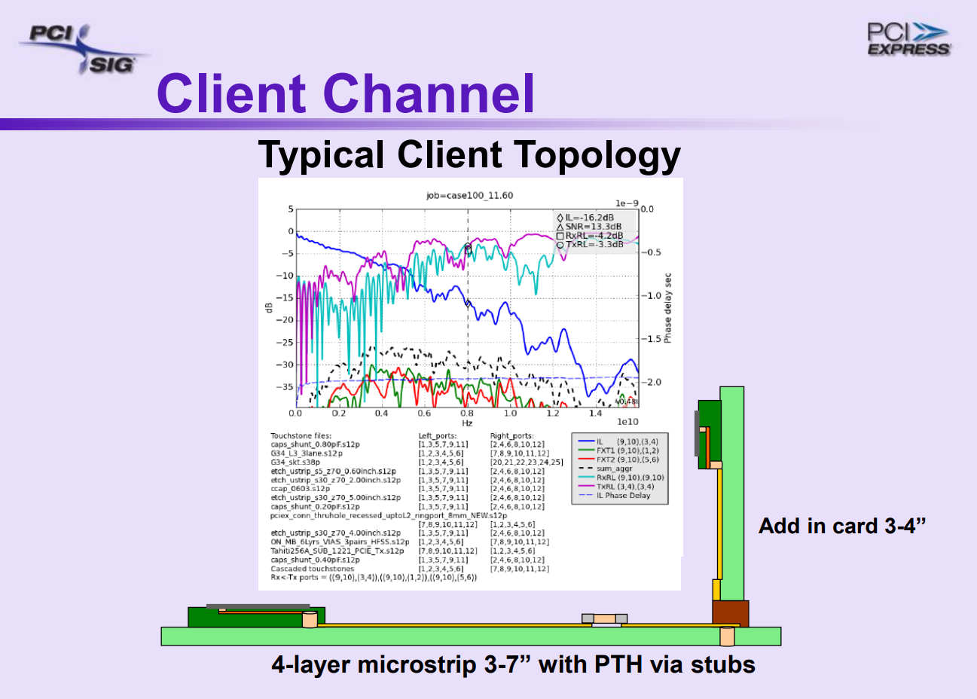
Summary

Slide 11
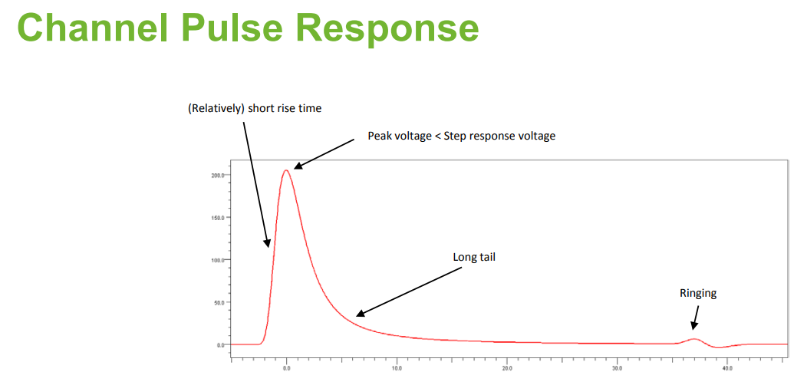
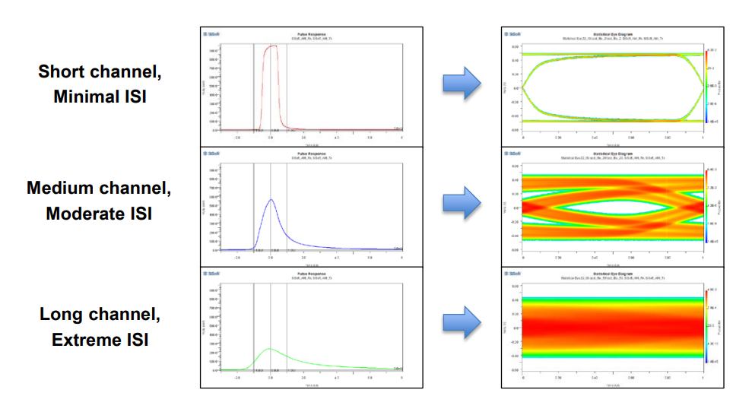
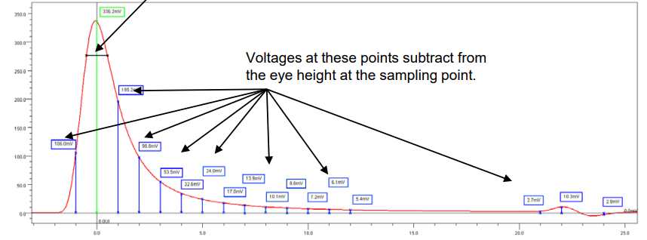
Summary

Slide 12
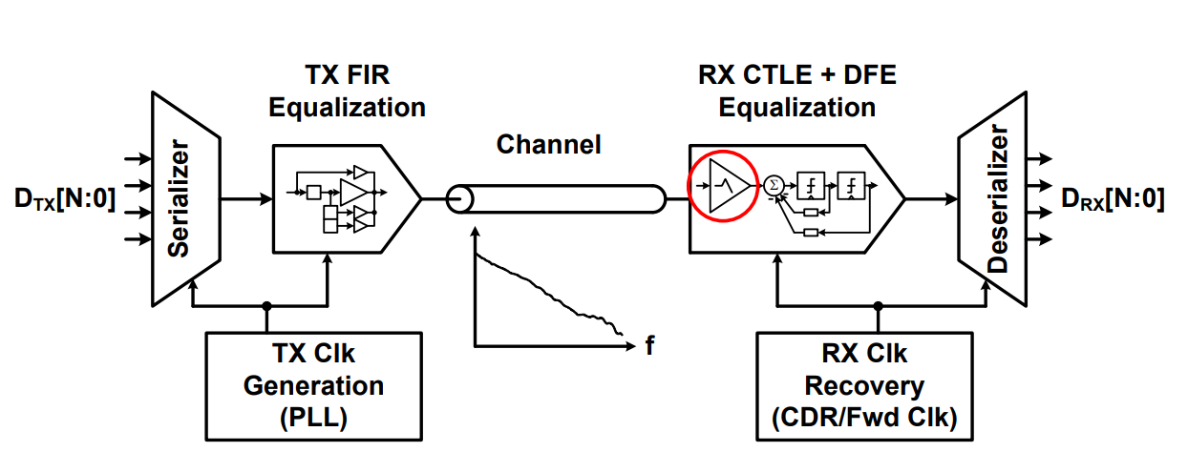
SerDes basics

Slide 13
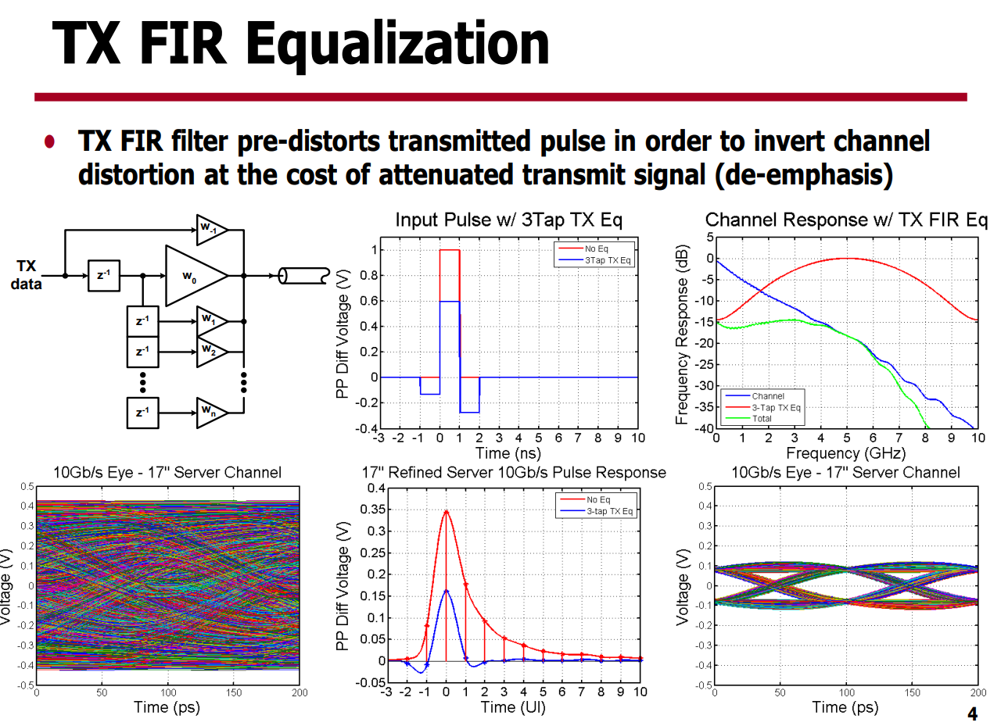
Summary

Slide 14
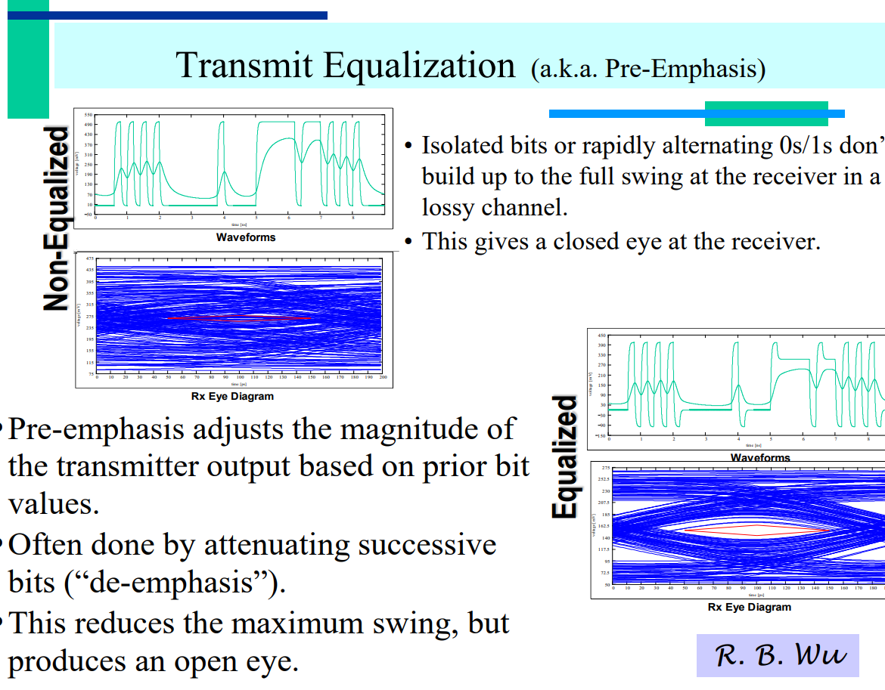
Summary

Slide 15
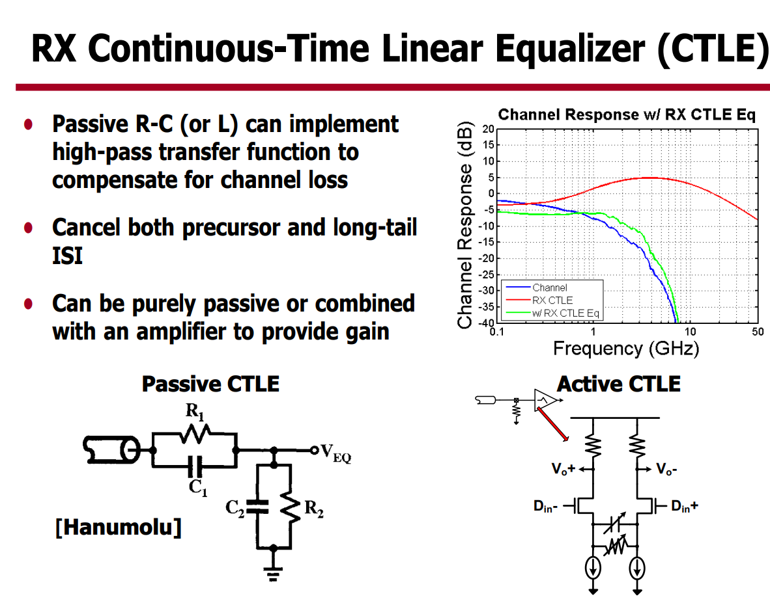
Summary

Slide 16
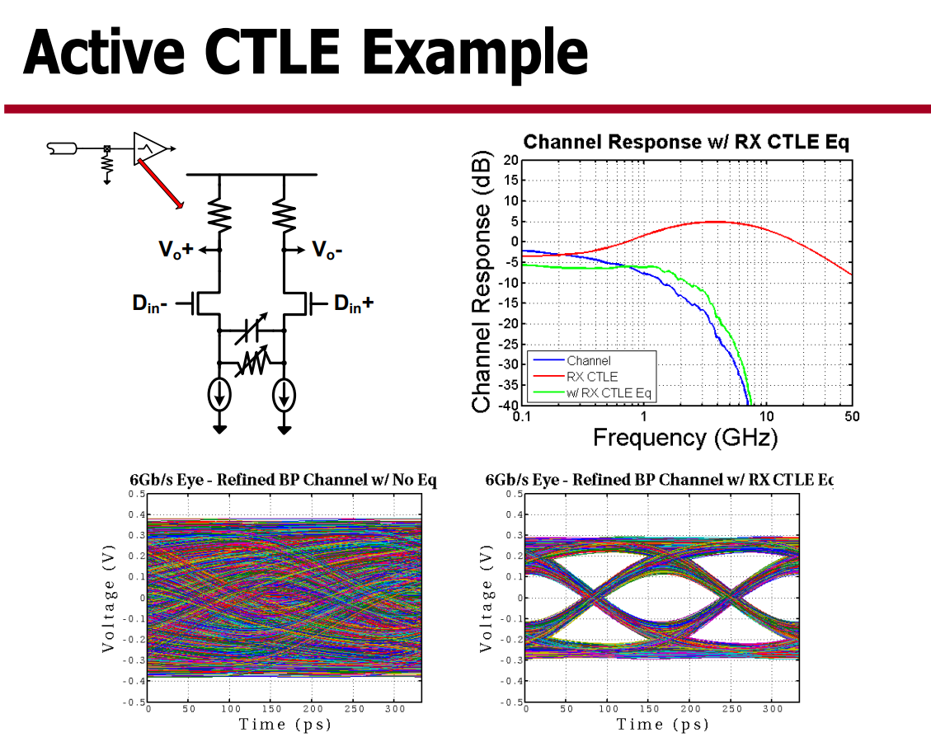
Summary

Slide 17
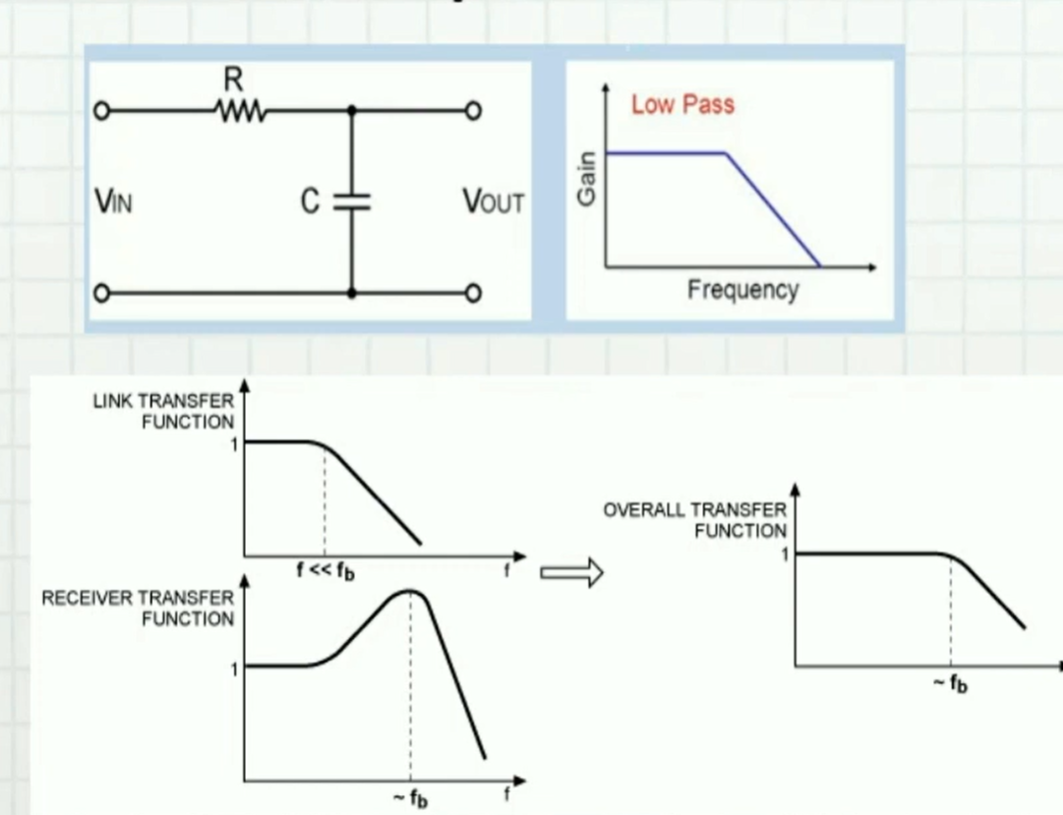
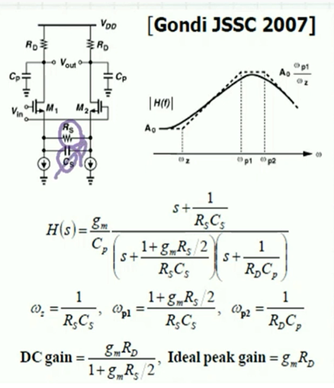
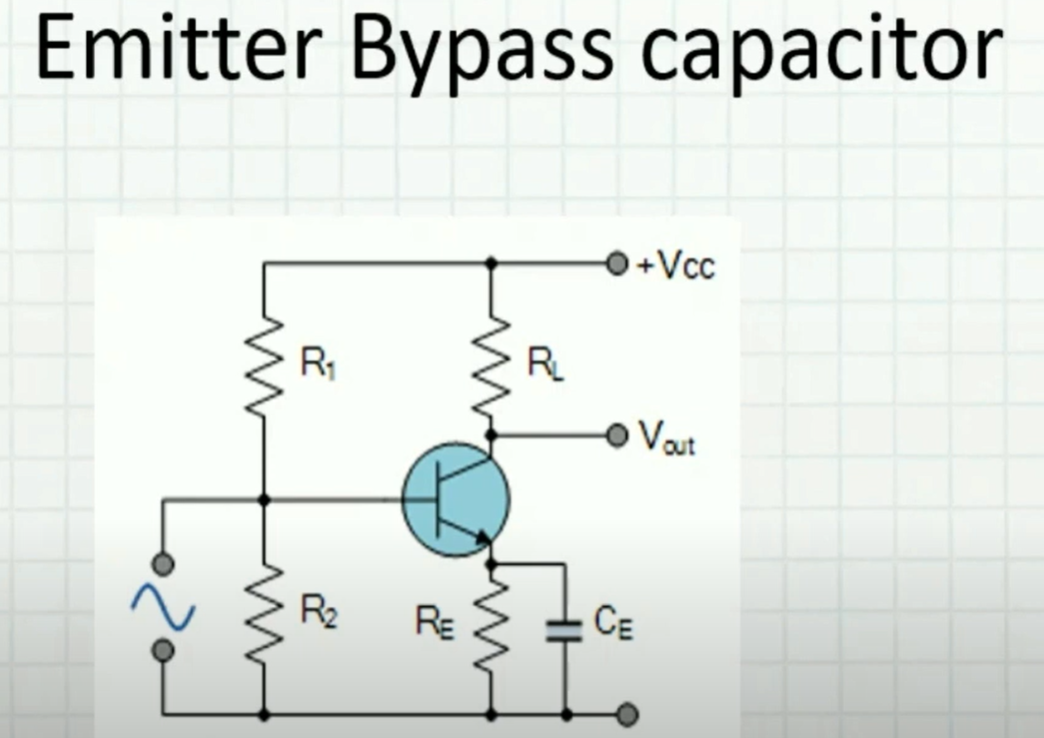
CTLE – Continues time linear equalizer

Slide 18
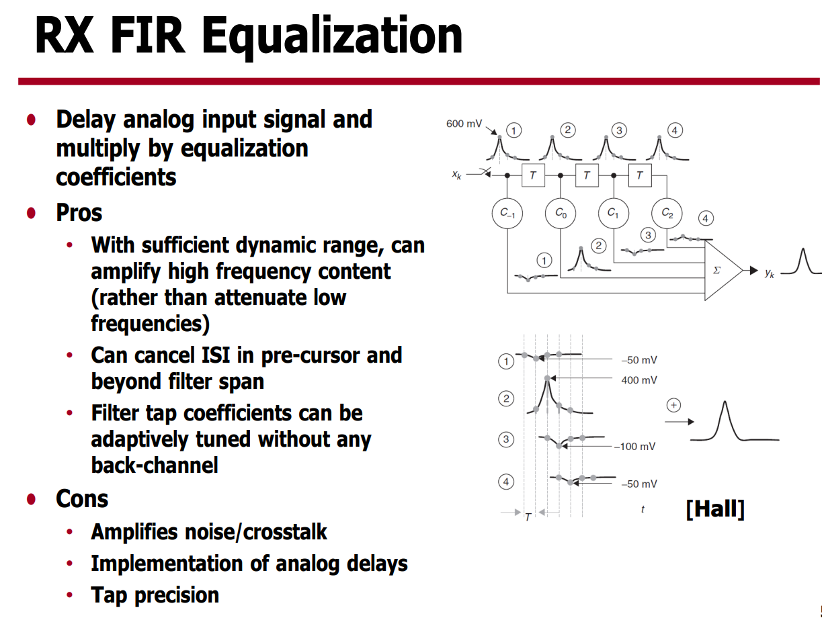
Summary

Slide 19
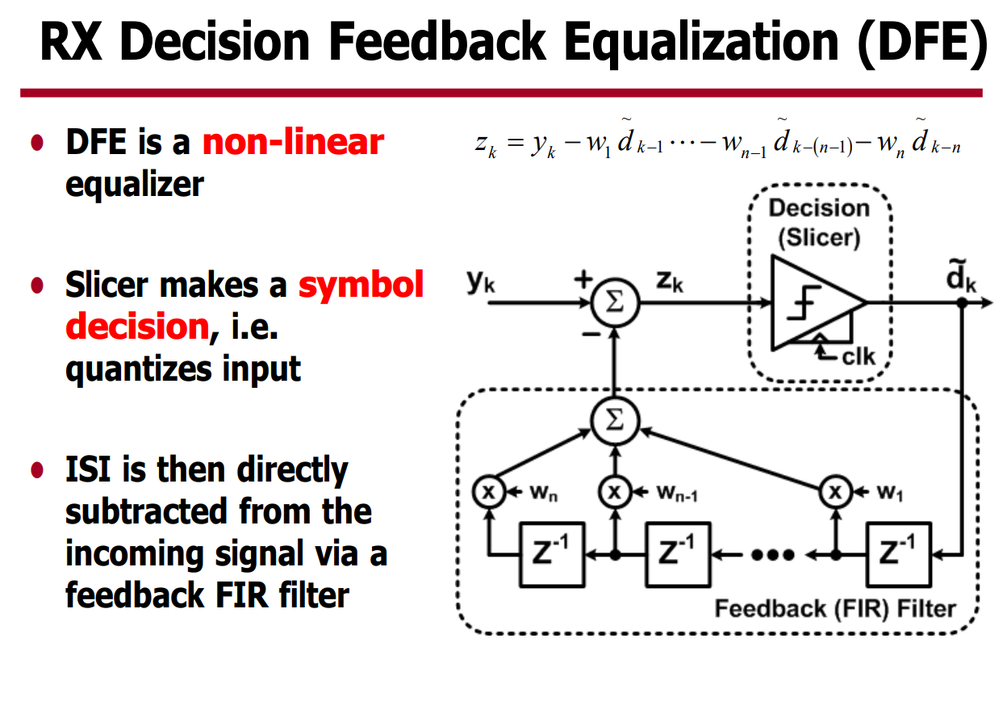
Summary

Slide 20
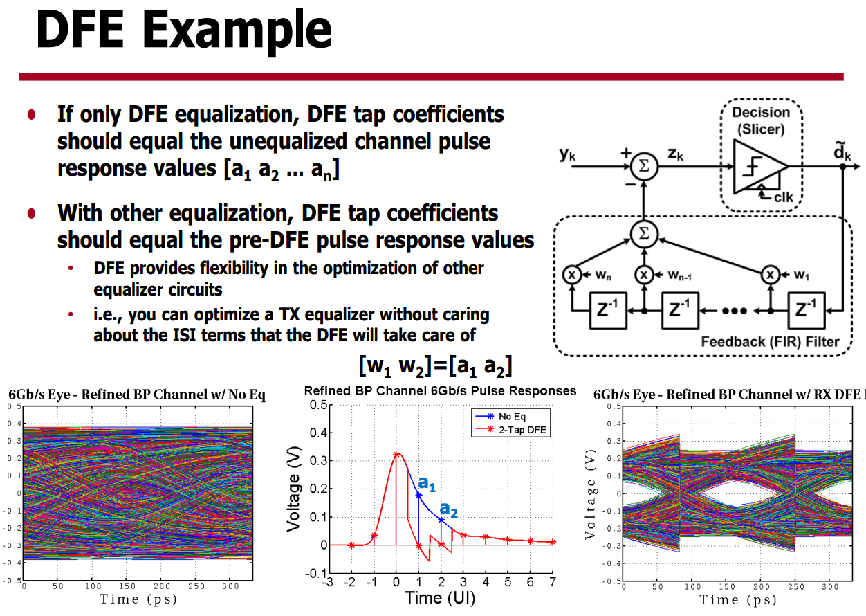
Summary

Slide 21
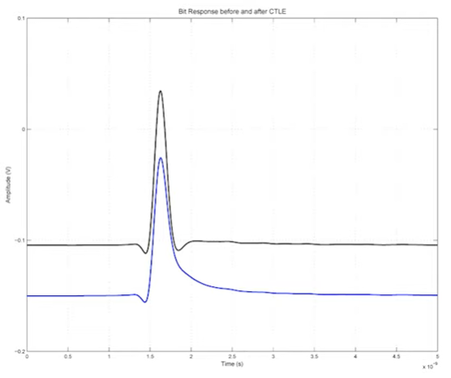
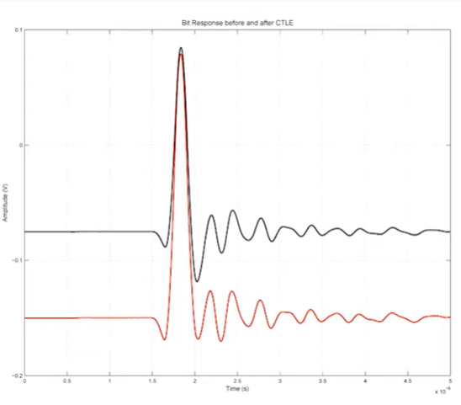
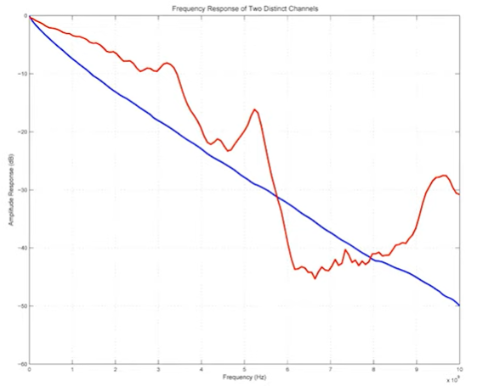
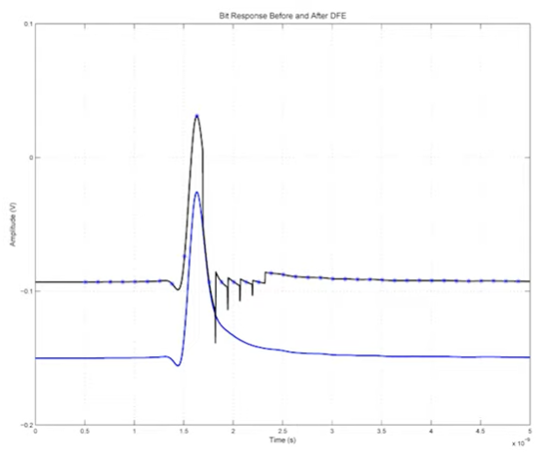
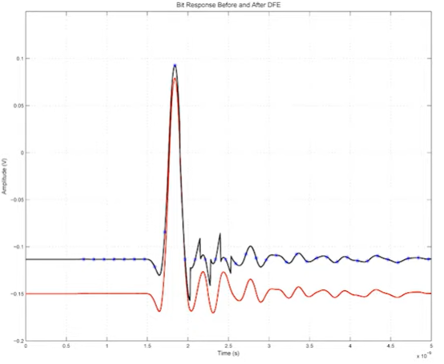
CTLE or DFE – depends on channel bumpiness
IL for of tow channels
CTLE
bit response
DFE
bit response

Slide 22
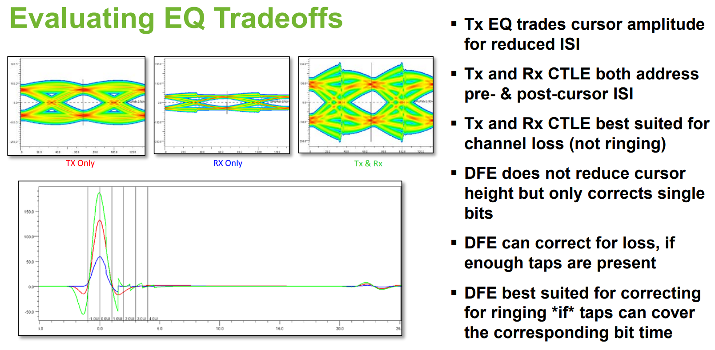
Summary

Slide 23
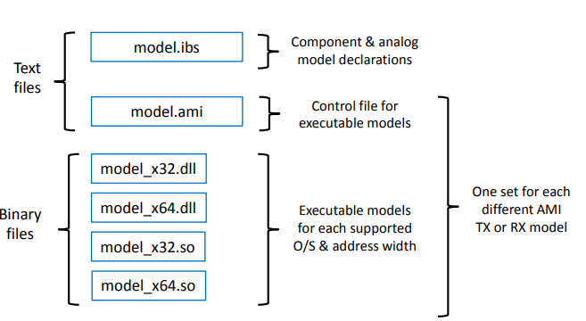
IBIS-AMI simulations
IBIS-AMI flow is invented and driven by SiSoft
IBIS model is supplemented with [Algorithmic Model] that defines external TX / RX.dll with corresponding .ami file
The equalization is performed inside TX / RX.dll. Hyperlynx feeds it with a channel’s step response and a bit sequence.
In Hyperlynx it’s incapsulated in AmiRunner.dll

Slide 24
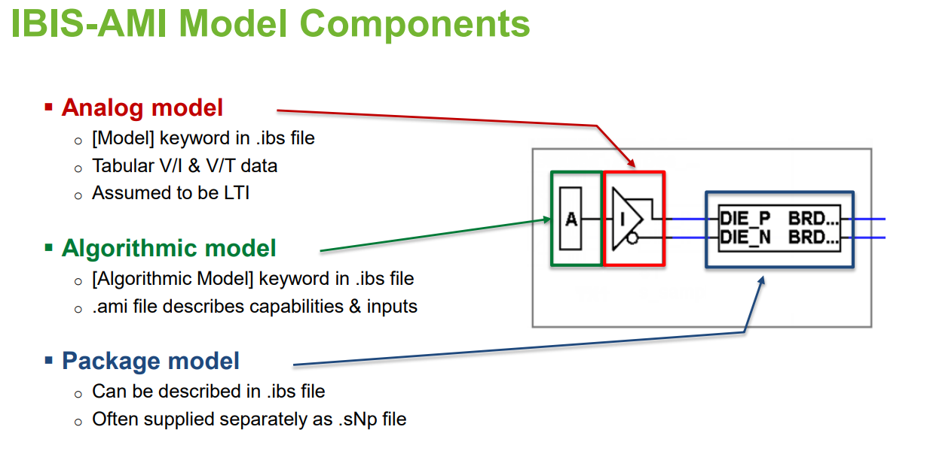
Summary

Slide 25
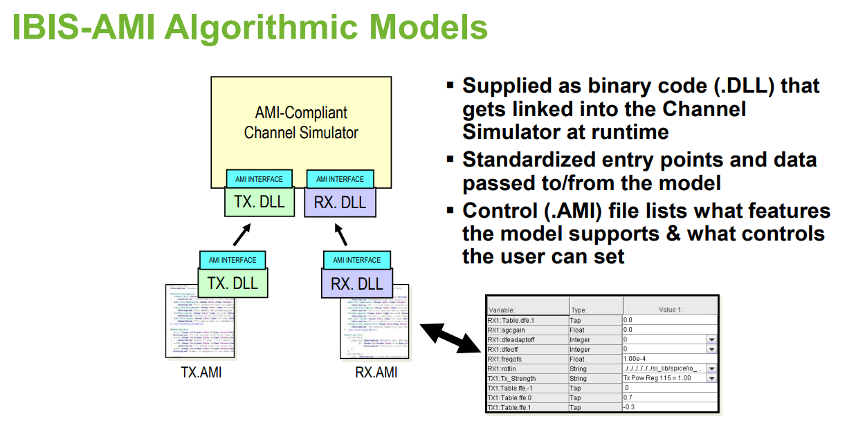
Summary

Slide 26
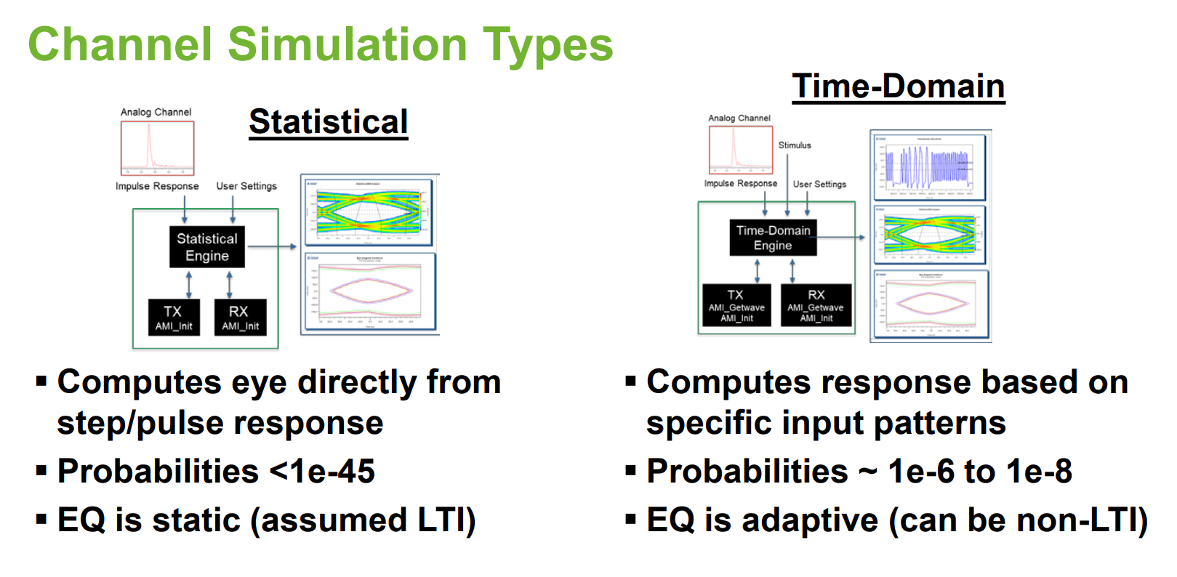
Summary

Slide 27
Summary

Slide 28
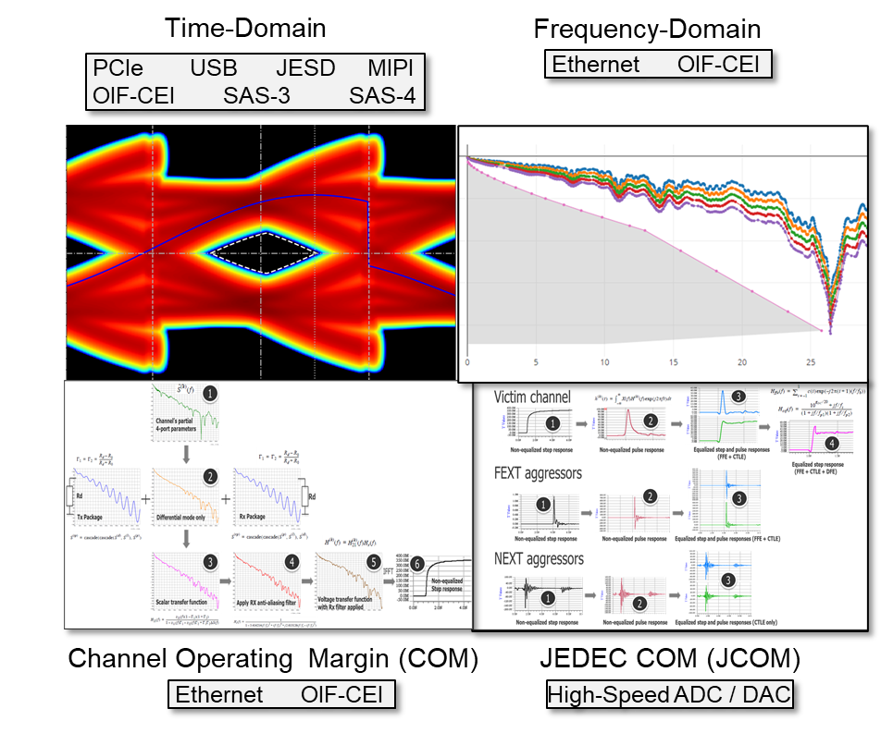
Analyzing Serial Channels for Protocol Compliance
Dozens of specs, hundreds of pages (each)
Who has time to read them?
Differing analytical methods and Pass/Fail criteria:
Time-domain (eye masks)
Frequency-domain (frequency masks)
Channel Operating Margin (COM metric)
JEDEC Channel Operating Margin (JCOM metric)

Slide 29
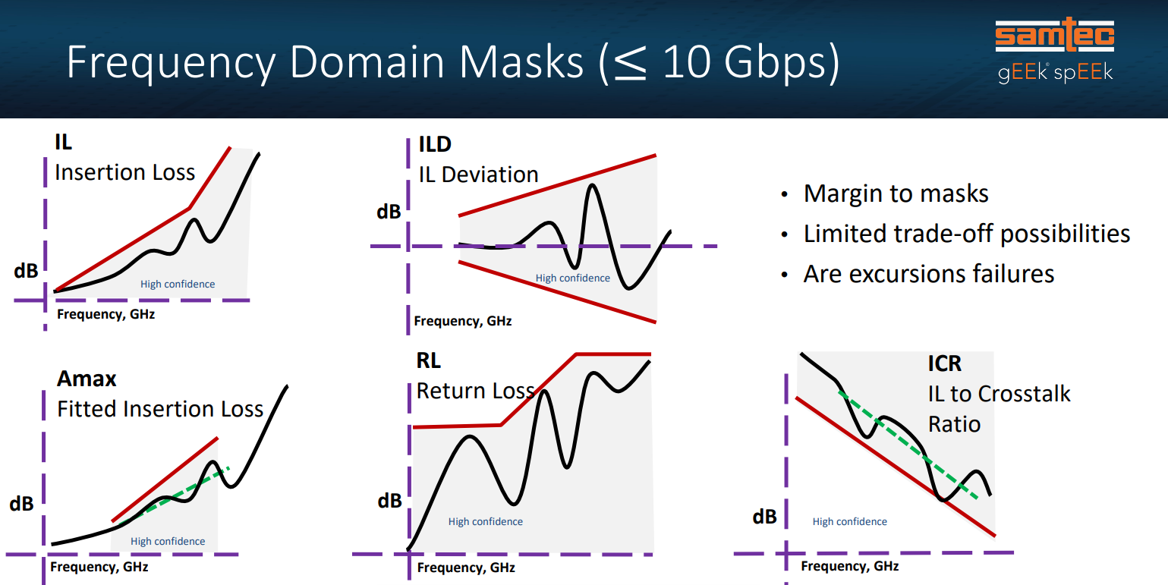
Summary

Slide 30
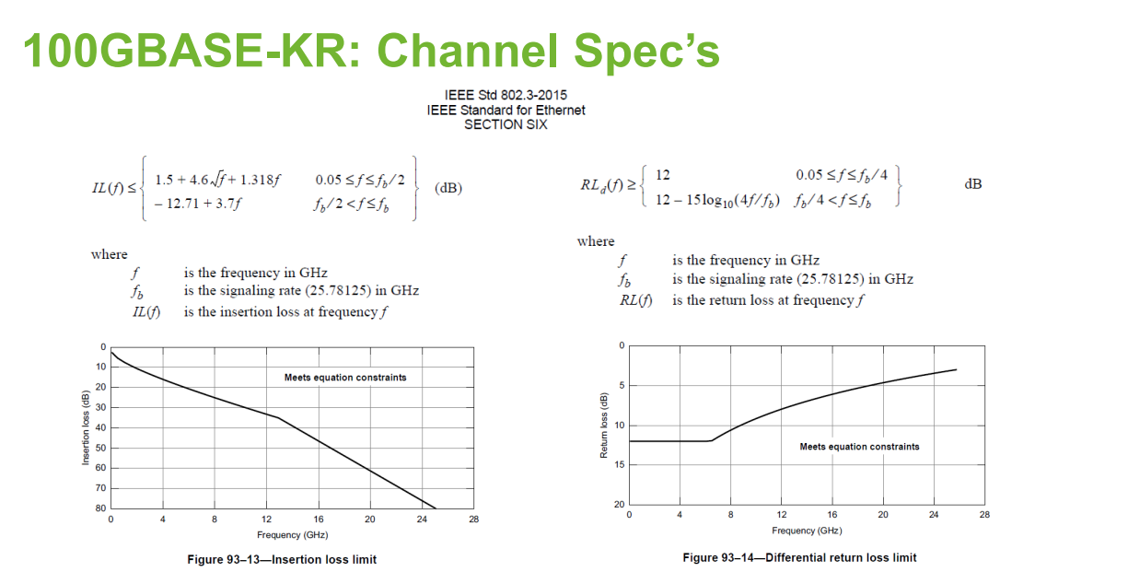
Summary

Slide 31
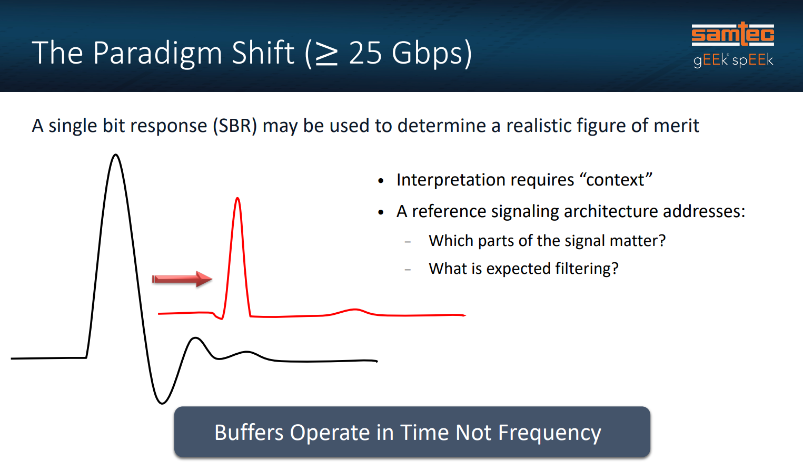
Summary

Slide 32
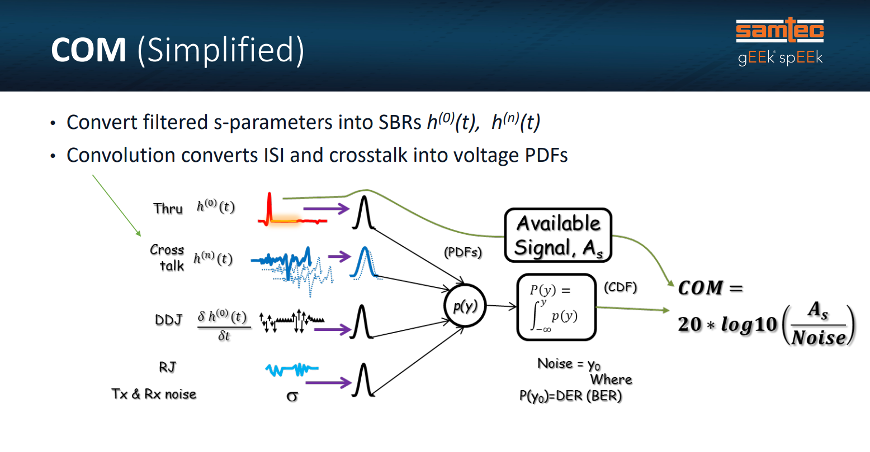
Summary

Slide 33
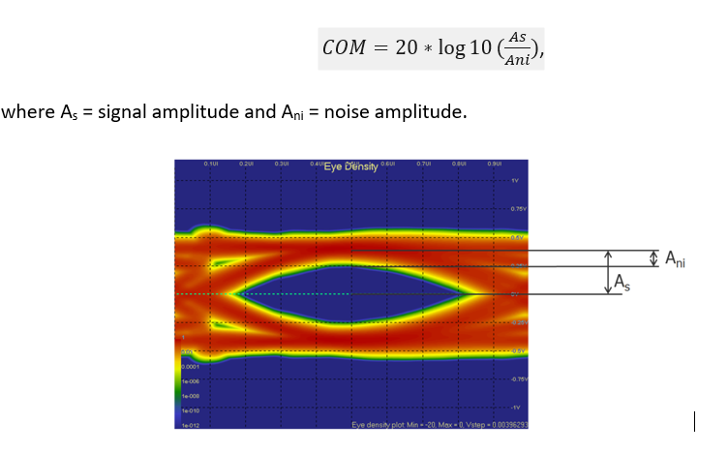
COM
COM is “a figure of merit for a channel derived from a measurement of its scattering parameters”. COM is a single value scalar, expressed in dB, and measures the ratio of the available signal to the total peak noise:

Slide 34
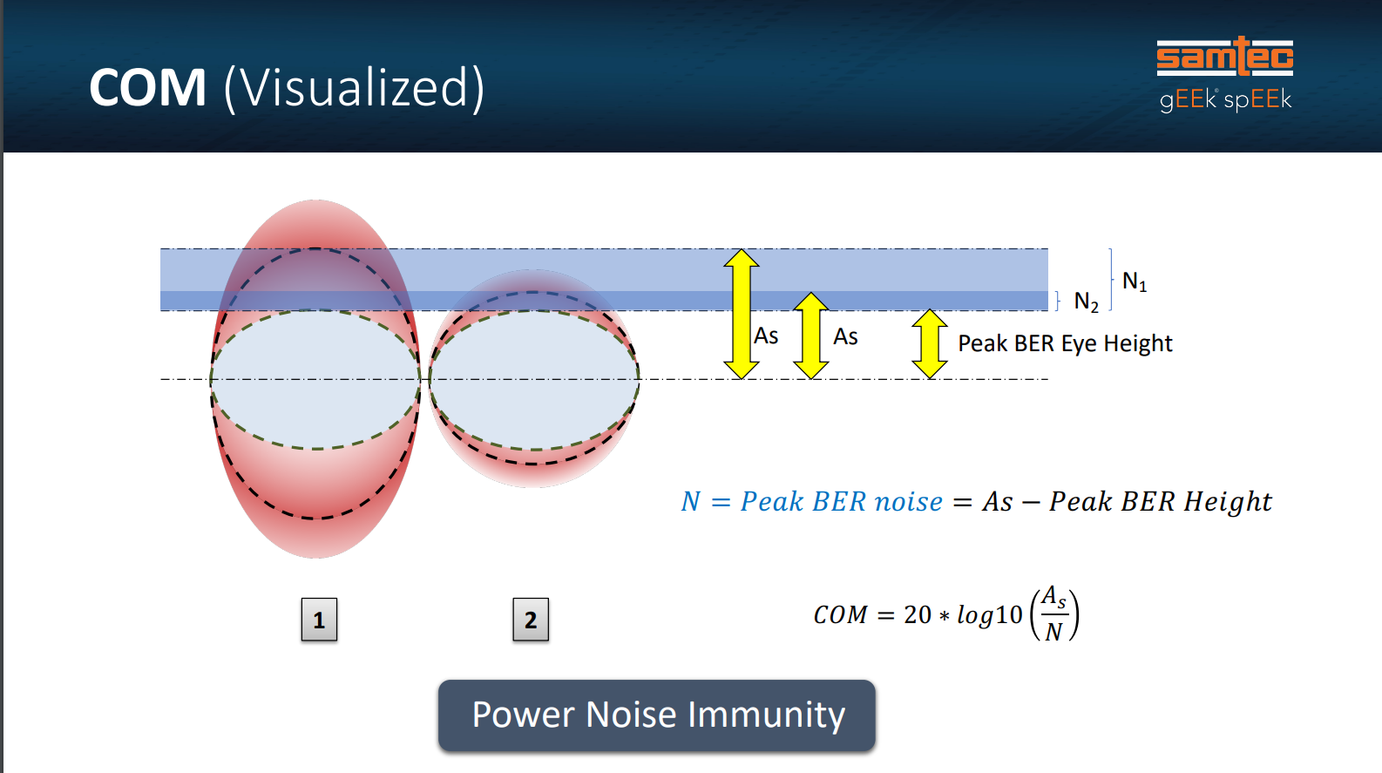
Summary

Slide 35
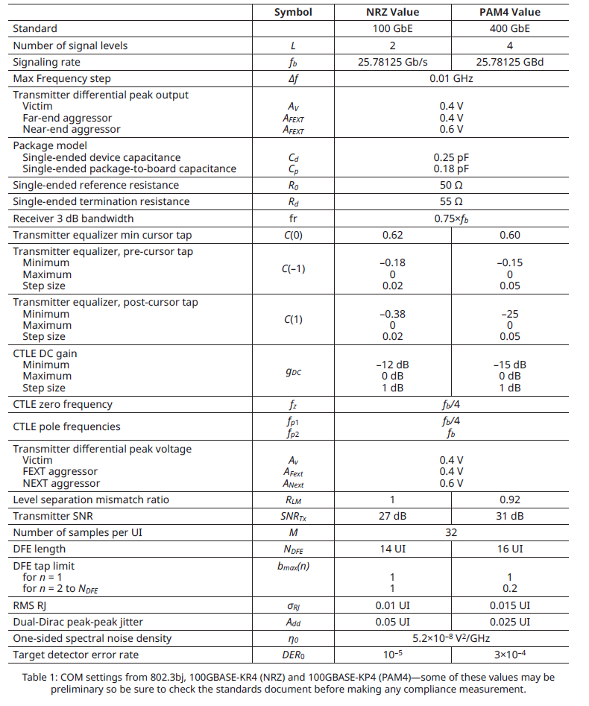
Summary

Slide 36
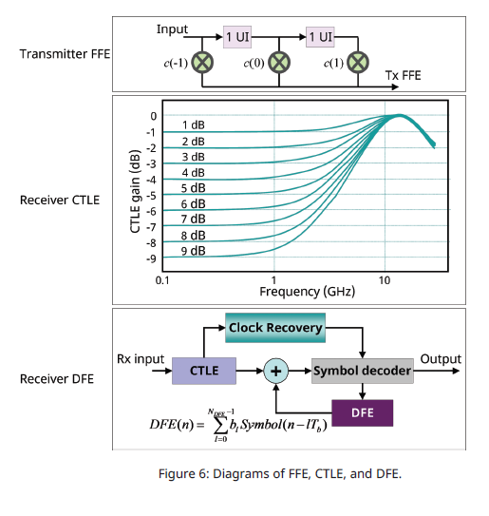
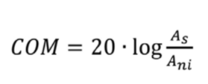
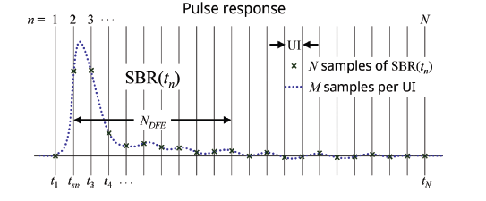
Finding COM
Optimize Transmitter FFE and Receiver CTLE for max As using channel pulse response.
Noise probability density function (pdf) are calculated for each disturbance source. Noise as inter symbol interference (ISI), voltage noise, crosstalk, jitter etc. is considered in the calculation of the combined total noise pdf
The noise level, Ani, at the sampling point, for the specified DER0 is calculated from the total noise pdf

Slide 37
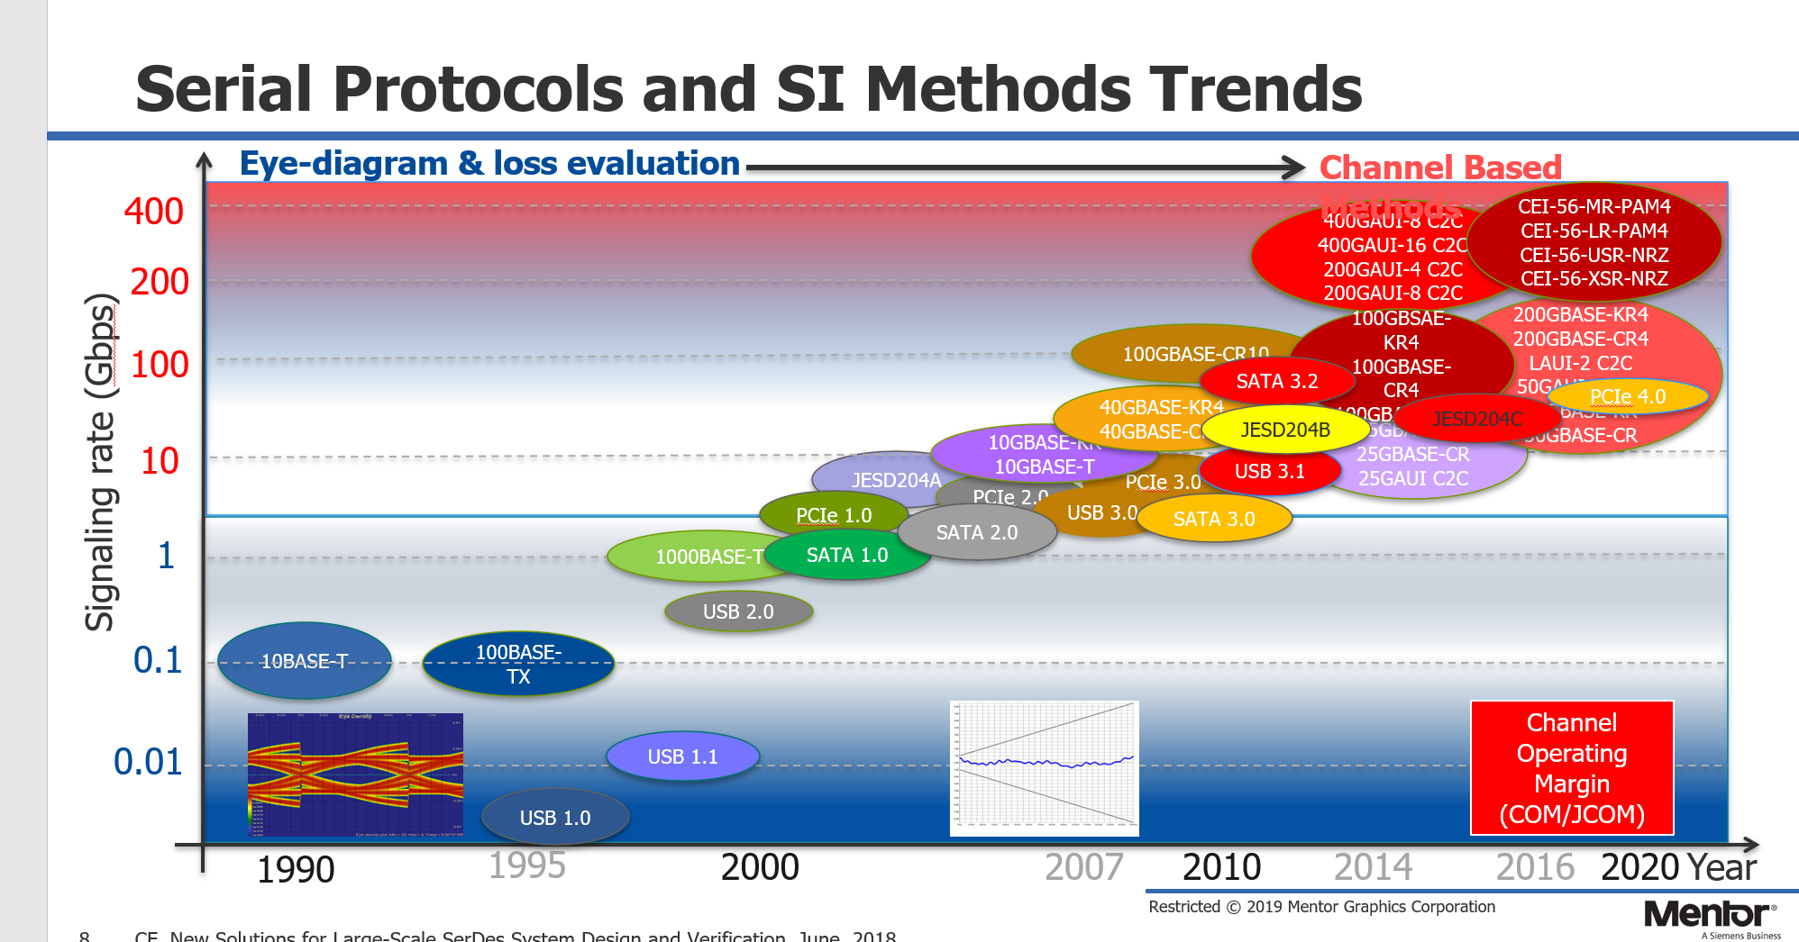
Summary
The end

Slide 38
Analyzing Serial Channels for Protocol Compliance
Dozens of specs, hundreds of pages (each)
Who has time to read them?
Differing analytical methods and Pass/Fail criteria:
Time-domain (eye masks)
Frequency-domain (frequency masks)
Channel Operating Margin (COM metric)
JEDEC Channel Operating Margin (JCOM metric)

Slide 39
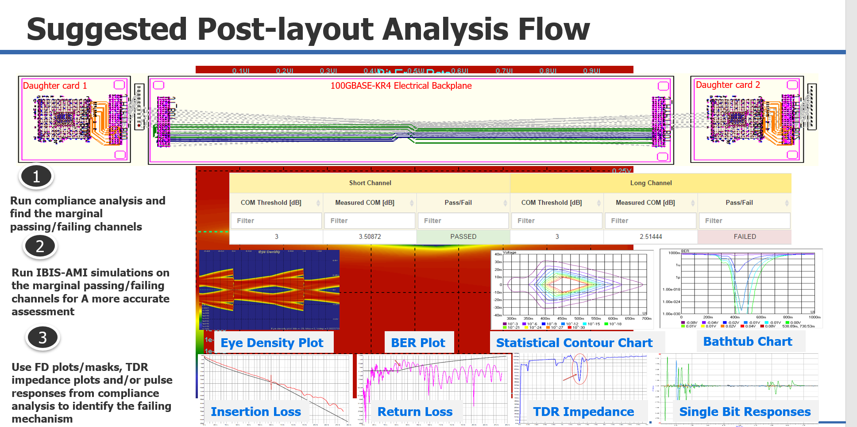
Summary

Slide 40
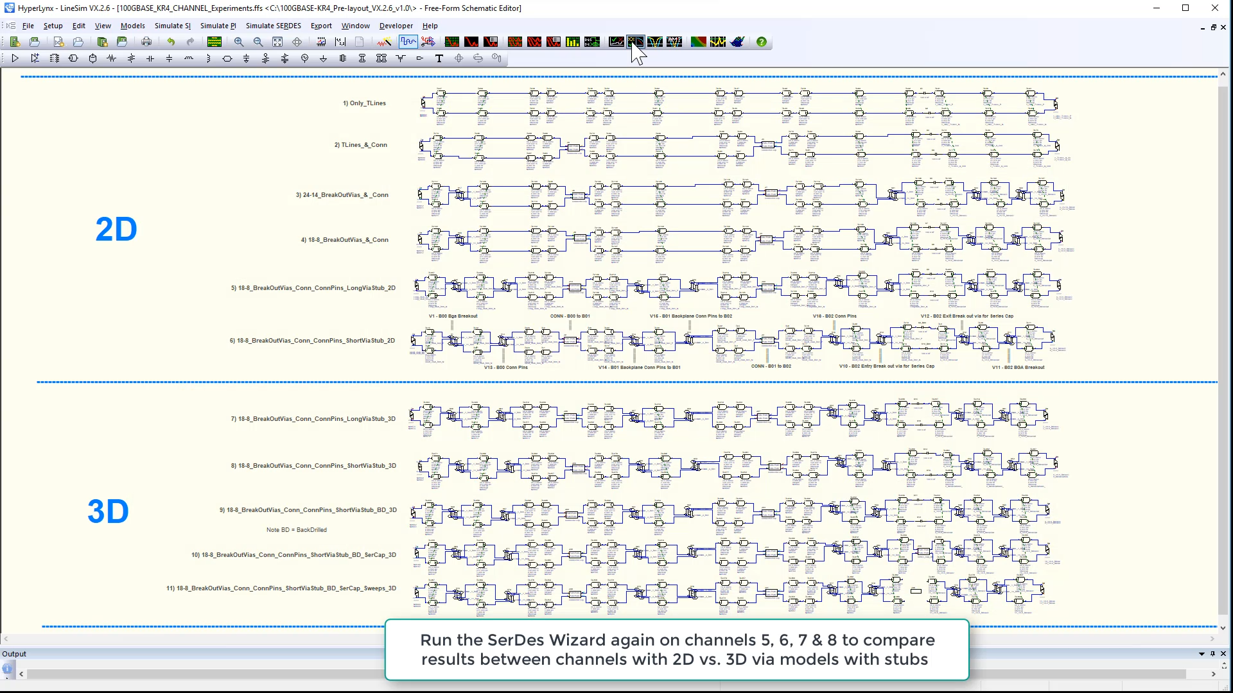
Summary

Slide 41
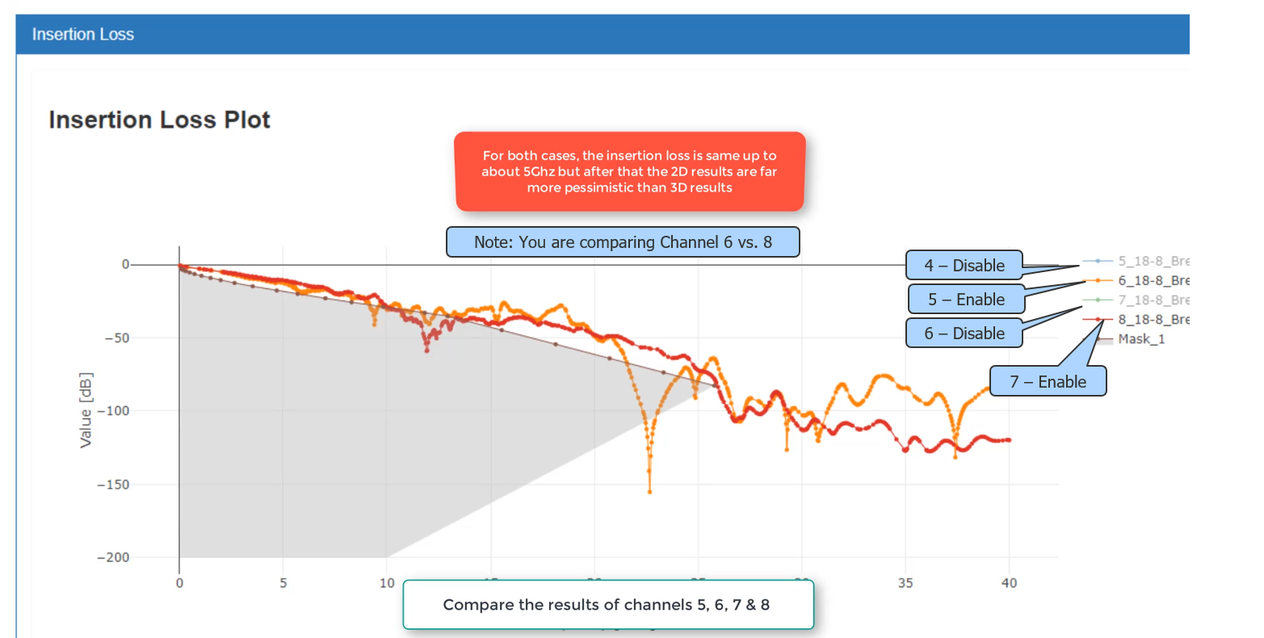
Summary

Slide 42

Summary

Slide 43

Summary

Slide 44


Summary

Slide 45

Summary

Slide 46

Summary

Slide 47

Summary

Slide 48
Summary

Slide 49

Summary

Slide 50
Summary

Slide 51
Summary

Slide 52
Summary

Slide 53

Summary

Slide 54



Summary

Slide 55
Summary

